Slide 1
Obesity –
More Complicated Than It Seems
Louis J. Aronne, MD, FACP
Professor of Clinical Medicine
Weill Cornell Medical College
Adjunct Associate Professor of Clinical Medicine
Columbia University College of Physicians and Surgeons
Director, Comprehensive Weight Control Program
New York-Presbyterian Hospital/Weill Cornell Medical Center
New York, NY
ljaronne@med.cornell.edu

Slide 2
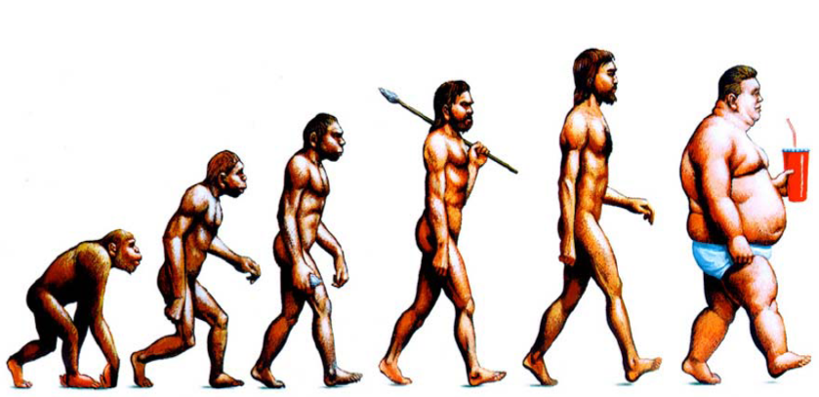
Evolution?

Slide 3
U.S. Obesity Prevalence, 1960-2008
More Than Half of Adults are Overweight or Obese
73.9%
Extremely Obese
(BMI = 40)
6.0%
45.8%
34.3%
Obese
(BMI = > 30)
0.9%
13.4%
Overweight
(BMI = 25-29.9)
31.5%
33.6%
NHLBI. Obes Res. 1998;6(suppl 2):51S-209S.
Flegal, et al. Int J Obes. 1998;22:39-47.
www.cdc.gov/nchs/data/hestat/obesity_adult_07_08/obesity_adult_07_08.htm
Notes:
It is projected that by 2008, 73% of us will be overweight or obese. It took us over 40 years to go up 20%, now we’re going up 10% in 5 years!
This illustrates the increase in obesity in the last few decades.
Number of Obese American adults rose to 24.5%
Over last decade alone an increase of 12% - overweight 70% - obese
Occurred for all population subsets: children, elderly & all racial/ethnic groups
According to projections, 73 percent of American adults could be overweight (34 %) or obese (39 %) by 2008*
BMI ≥ 40 - quadrupled in 17 years
1983 - @1.2 million to 2000 - @5.64 million
(Roland Sturm, PhD, Arch Intern Med. 2003;163:2146-2148)
Media reports, official pronouncements, a national summit and, now, this report, America's Health: State Health Rankings, all have focused our nation's attention on obesity and overweight as a fast-growing, major threat to people's health. Physical inactivity and poor nutrition - risk factors that contribute to obesity and overweight –
together are the second leading cause of premature death, behind only tobacco. These risk factors contribute to arthritis, asthma, cancer, diabetes, heart disease, stroke and other deadly and debilitating diseases. They cost our nation dearly in the following ways:
The direct and indirect costs of obesity in the United States total $117 billion.
Obesity costs our economy more than 39 million lost work days each year.
Three-fourths of the $1.4 trillion the United States spends on health care is
to treat chronic illnesses, many of which are tied to obesity and overweight.

Slide 4
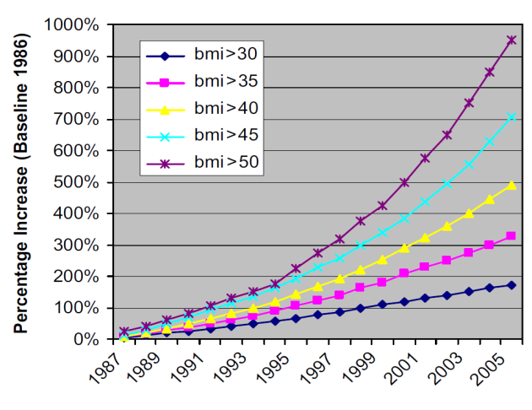
The Highest BMI’s are Increasing Most Rapidly US 1987-2005 - Why?
←
BMI >50
Increased 75%
In 5 years
BMI >45
←
BMI >40
Increased 52%
←
BMI >30
Increased 24%
Sturm R. Pub Hlth. 2007 Jul;121:492-496.
Notes:
Background: It is well known that citizens of developed countries are more likely to be overweight than they were 20 years ago. The most serious health problems are not associated with overweight or moderate obesity, however, but with clinically severe or morbid obesity (e.g. more than 100 pounds (45 kg) overweight). There is no reason to expect that morbid obesity trends parallel overweight or moderate obesity. If morbid obesity is a rare pathological condition that has biological causes, the more than 10-fold increase in bariatric surgery procedures over the past eight years in the USA could have even towered the prevalence of morbid obesity--and may very well stem the problem in other countries. Objective: To estimate trends for extreme weight categories (BMI > 40 and > 50) for the period between 1986 and 2005 in the USA, and to investigate whether trends have changed since 2000. Methods: Data from The Behavioral Risk Factor Surveillance System (a random-digit telephone survey of the household population of the USA), for the period from 1986 to 2005, were analysed. The main outcome measure was body mass index (BMI), calculated from self-reported weight and height. Results: From 2000 to 2005, the prevalence of obesity (serf-reported BMI over 30) increased by 24%. However, the prevalence of a (serf-reported) BMI over 40 (about 100 pounds (45 kg) overweight) increased by 50% and the prevalence of a BMI over 50 increased by 75%, two and three times faster, respectively. The heaviest BMI groups have been increasing at the fastest rates for 20 years. Conclusions: The prevalence of clinically severe obesity is increasing at a much faster rate among adults in the USA than is the prevalence of moderate obesity. This is consistent with the public health idea that the population weight distribution is shifting, which disproportionately increases extreme weight categories. Because comorbidities and resulting service use are much higher among severely obese individuals,..
Public Health (Elsevier); Jul2007, Vol. 121 Issue 7, p492-496, 5p, 1 chart, 1 graph

Slide 5
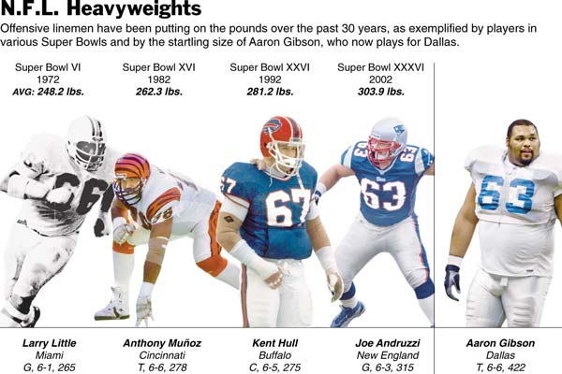
American Football Linemen are 30 Kg
Heavier Than in 1972 !
XLV
2011
316.3

Slide 6


Competitive eating Champion–
How does she stay thin?
Sonya Thomas
Weight: 105
Age: 44
  Some of her records
  40 Hot dogs in 10 minutes
  43 tacos in 11 minutes
  5.5 pounds Deep Fried Aspargus Spears in10 minutes
  134 chicken wings in 12 minutes
  65 Hard Boiled Eggs in 6 minutes, 40 seconds
  7 3/4 pound burgers in 10 minutes
  9 Pounds Crawfish Jambalaya in 10 Minutes
  23 pulled pork sandwiches in 10 minutes

Slide 7
Facts About Obesity in France
Obesity levels in France have doubled between 1995 and 2004 (to 11.3% of the population)
38.5% of men and 26% of women in France are considered overweight while 60% of men and 43% of women in Germany are considered overweight.[
Nord-Pas-de-Calais is considered the fattest region in France.
Obesity is rising 6 % annually in adults
In children the rate of growth is 17 % per year
McDonald's is more profitable in France than anywhere else in Europe.
The average French meal, which 25 years ago lasted 88 minutes, is just 38 minutes today.

Slide 8
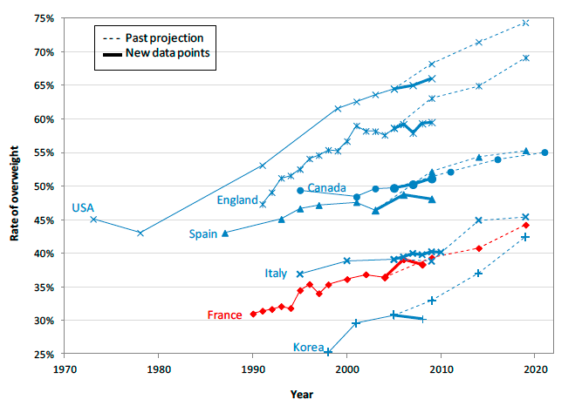
Overweight in France has increased from more than 30% in 20 years

Slide 9
What’s Causing the Epidemic of Obesity?
Ten Contributors to the Obesity Epidemic
The usual suspects
Too much fattening food
Not enough exercise
Some new ideas
Central air/heating reduce temperature variability
Reduced length of sleep
Intestinal bacteria changes from antibiotics
Medications that cause weight gain
Changes in gene expression like DNA methylation from dietary changes
Older maternal age
Fertility treatments
Chemical endocrine disruptors
Intrauterine and intergenerational effects
Crit Rev Food Sci Nutr. 2009 November ; 49(10): 868–913

Slide 10
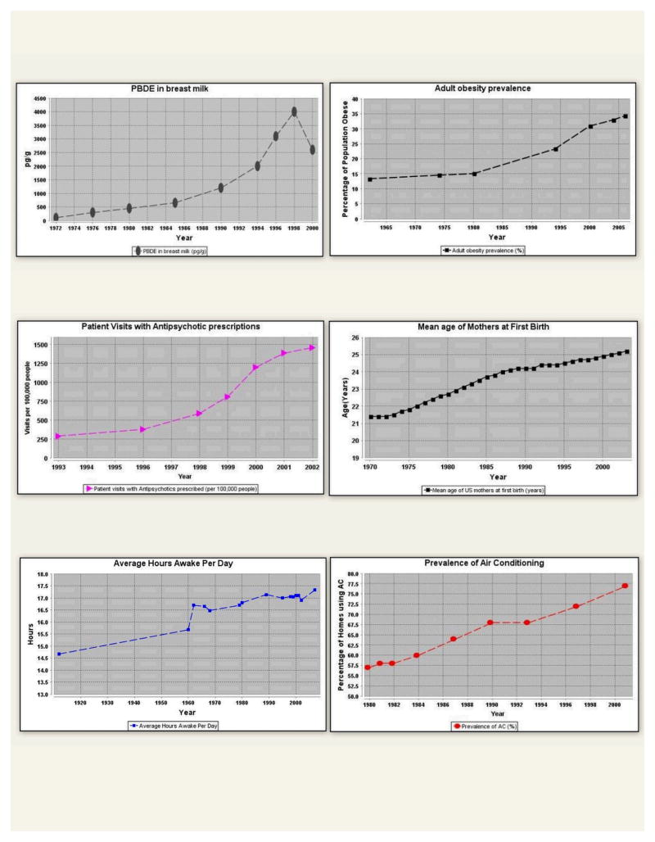
Endocrine Disruptor in Breast Milk
Obesity Prevalence
Every One Trends UP !
There are many
contributors to the
epidemic of obesity
Pt Visits with Antipsychotics
Mother’s Age at 1st Birth
Hours Awake/Day
Prevalence Air Conditioning
Crit Rev Food Sci Nutr. 2009 November ; 49(10): 868–913

Slide 11
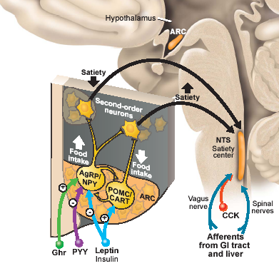
Obesity Seems to Overload Critical Brain Pathways
Food intake
↓ energy expenditure
food intake
energy expenditure

Slide 12
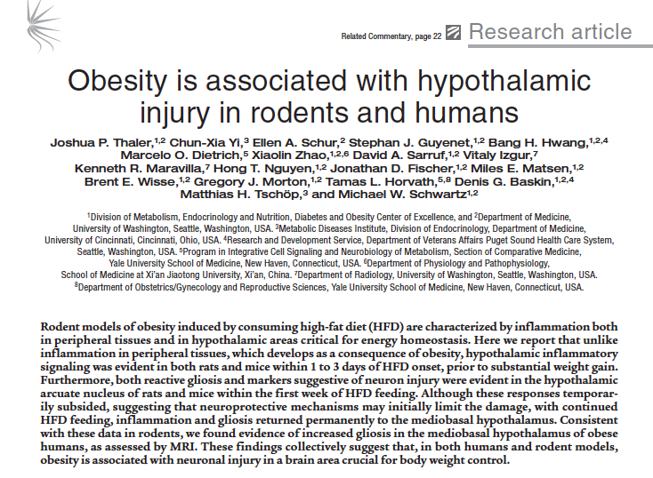
J Clin Invest. 2012 Jan 3;122(1):153-62. doi: 10.1172/JCI59660. Epub 2011

Slide 13
What’s Fattening About Fattening Food?
Has too many calories
Has too much starch, sugar, and fat
It is cheap
Damages your hypothalamic POMC neurons more than healthy food, so you lose neurons and your brain thinks you’re losing weight, even though you are gaining weight!

Slide 14
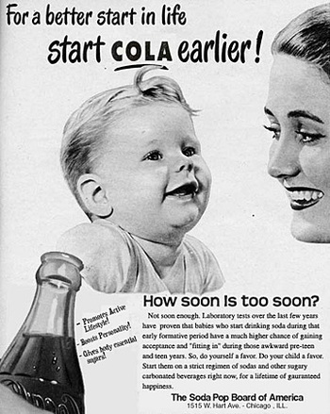

Slide 15
Why Do Doctors Care About Weight? Weight Gain Causes More Than 60 Diseases!
Pulmonary disease
asthma
obstructive sleep apnea
hypoventilation syndrome
Idiopathic intracranial hypertension
Stroke
Cataracts
Nonalcoholic fatty liver disease
steatosis
steatohepatitis
cirrhosis
Coronary heart disease
Diabetes
Dyslipidemia
Hypertension
Gall bladder disease
Severe pancreatitis
Gynecologic abnormalities
abnormal menses
infertility
polycystic ovarian syndrome
Cancer
breast, uterus, cervix
colon, esophagus, pancreas
kidney, prostate
Osteoarthritis
Skin
Phlebitis
venous stasis
Gout
Notes:
13
13
Obesity is associated with complications involving many organ systems. The most common medical complications include coronary heart disease, hypertension, diabetes, dyslipidemia, liver disease, gall bladder disease, pulmonary abnormalities, and osteoarthritis. The complications associated with obesity lead to impaired quality of life, considerable morbidity, and premature death. The mechanisms responsible for many of these complications are not completely understood but probably involve the mechanical burden from excess bulk; signaling proteins produced and secreted by adipocytes; and abnormalities in lipid metabolism within adipose tissue, cardiac and skeletal muscle, and the liver and pancreas.

Slide 16
How does obesity cause diseases?
Too much fat, too much of the hormones
Type 2 DM
Angiotensinogen
Hypertension
Lactate
Inflammation
Atherogenic
Dyslipidemia
IL-6
Arthritis
Leptin
FFA
Insulin
Fat Stores
TNF-α
Type 2 DM
Cancer
Resistin
Adipsin (Complement D)
Thrombosis
Estrogen
Plasminogen Activator Inhibitor 1 (PAI-1)
ASCVD
Adiponectin
DM=diabetes mellitus; FFA=free fatty acid; PAI-1=plasminogen activator inhibitor-1;
TNFα=tumor necrosis factor-alpha; IL-6=interleukin 6; ASCVD=atherosclerotic cardiovascular disease.
Bray, G. J Clin Endocrinol Metab. 2004;89:2583-2589.
Eckel RH, et al. Lancet. 2005;365:1415-1428.
Slide: After Dr. G. Bray.
Notes:
How Obesity Causes Disease: The Fat Cell—A Multiendocrine Organ
Obesity is associated with hormonal and metabolic changes that promote inflammation and chronic disease, including diabetes and CV disease. This slide shows some of the specific effects that are associated with excess adiposity, abdominal adiposity in particular.
Lifestyle intervention is the first-line approach to the management of obesity. The process of assessment, classification, and treatment of obesity is like the evaluation and treatment of any chronic disease. For patients who cannot achieve weight loss and favorably modify cardiometabolic risk factors with lifestyle intervention alone, adjunctive long-term pharmacotherapy, or in some cases bariatric surgery, may be indicated. A goal of 5% to 10% body weight loss is achievable with non-surgical treatments and will improve obesity-related health outcomes. Chronic treatment is required, and relapse can be expected if treatment is discontinued.
A growing body of evidence supports the contention that obesity is a disease worthy of treatment in the healthcare setting. However, in spite of the comorbidities associated with obesity, it is not treated by the vast majority of primary care physicians. Instead, healthcare providers treat the chronic conditions, such as coronary artery disease, diabetes, hypertension, and dyslipidemia, that are complications of obesity and account for a large number of patient visits and healthcare dollars. It seems reasonable to give the same attention to the treatment of obesity that is given to other chronic diseases.

Slide 17

The Fires Within
Inflammation is the body's first defense against infection, but when it goes awry, it can lead to heart attacks, colon cancer, Alzheimer's and a host of other diseases
By CHRISTINE GORMAN AND ALICE PARK
WHAT IS THE SOURCE
OF INFLAMMATION ?
OBESITY

Slide 18
Caloric restriction reverses obesity-induced mammary gland inflammation in mice.
Bhardwaj P, Du B, Zhou XK, Sue E, Harbus MD, Falcone DJ, Giri D, Hudis CA, Kopelovich L, Subbaramaiah K, Dannenberg AJ.
Department of Medicine, Weill Cornell Medical College, New York, NY 10065, USA.
Abstract
Obesity is a risk factor for the development of hormone receptor-positive breast cancer in postmenopausal women.
Recently, we identified an obesity→inflammation→aromatase axis in mouse models and women.
Collectively, these findings provide a plausible explanation for the link between obesity, chronic inflammation, and postmenopausal breast cancer.
In summary, obesity-related inflammation of the mammary gland and elevated aromatase and PR levels were reversed with calorie restriction. Our results provide a rationale for determining whether weight loss can reverse breast inflammation associated with obesity in women.

Slide 19
Weight Loss Improves Fitness and Markers of Inflammation
In one study, a 5 kg weight loss improved:
All inflammatory markers associated with breast cancer
Hormones associated with breast cancer
  Estrogen, Insulin, and Leptin

Slide 20
The effect of intermittent energy and carbohydrate restriction v. daily energy restriction on weight loss and metabolic disease risk markers in overweight women.
Harvie M, Wright C, Pegington M,
Genesis Breast Cancer Prevention Centre, University Hospital of South Manchester NHS Foundation Trust, Southmoor Road, Manchester M23 9LT, UK.
2 days per week of a
low carbohydrate (< 40 grams) diet
or
less than 600 total calories per day
were as effective as a 1400 cal/day diet every day for 3 months
Br J Nutr. 2013 Apr 16:1-14. [Epub ahead of print]
Notes:
Intermittent energy restriction may result in greater improvements in insulin sensitivity and weight control than daily energy restriction (DER). We tested two intermittent energy and carbohydrate restriction (IECR) regimens, including one which allowed ad libitum protein and fat (IECR+PF). Overweight women (n 115) aged 20 and 69 years with a family history of breast cancer were randomised to an overall 25 % energy restriction, either as an IECR (2500-2717 kJ/d, < 40 g carbohydrate/d for 2 d/week) or a 25 % DER (approximately 6000 kJ/d for 7 d/week) or an IECR+PF for a 3-month weight-loss period and 1 month of weight maintenance (IECR or IECR+PF for 1 d/week). Insulin resistance reduced with the IECR diets (mean - 0·34 (95 % CI - 0·66, - 0·02) units) and the IECR+PF diet (mean - 0·38 (95 % CI - 0·75, - 0·01) units). Reductions with the IECR diets were significantly greater compared with the DER diet (mean 0·2 (95 % CI - 0·19, 0·66) μU/unit, P= 0·02). Both IECR groups had greater reductions in body fat compared with the DER group (IECR: mean - 3·7 (95 % CI - 2·5, - 4·9) kg, P= 0·007; IECR+PF: mean - 3·7 (95 % CI - 2·8, - 4·7) kg, P= 0·019; DER: mean - 2·0 (95 % CI - 1·0, 3·0) kg). During the weight maintenance phase, 1 d of IECR or IECR+PF per week maintained the reductions in insulin resistance and weight. In the short term, IECR is superior to DER with respect to improved insulin sensitivity and body fat reduction. Longer-term studies into the safety and effectiveness of IECR diets are warranted.

Slide 21
Conclusion
Fattening food damages the weight regulating system in the brain.
A “Feed forward” mechanism begins which makes it easier to gain and more difficult to lose.
The environment turns into something physical which causes further weight gain
Weight loss can reduce the risk of illnesses, including cancer

Slide 22
Conclusion
Obesity is a threat to the health gains we have made worlwide.
Prevention is critical. Spread the word!

Slide 23
Obesity Epidemic in US Adolescents
34% US adolescents (12-19 yrs) are overweight or obese
Overweight and obesity are most prevalent CVD risk factors in adolescents
The rate of diabetes and prediabetes among adolescents ages 12 to 19 rose from 9 percent in 1999-2000 to 23 percent in 2007-8, the most recent years for which data was analyzed.
49% of overweight and 61% of obese adolescents have ≥1 CVD risk factor
  HTN, high LDL-C, low HDL-c, pre-diabetes/diabetes

Slide 24
What’s the best exercise?
The best exercise to achieve the greatest weight loss is interval training, in which you vary the intensity of your activity
Hill climbing program on bike or cross trainer
The highest level of exercise intensity sets your “metabolism”
You can maintain twice the weight loss exercising for just one-half the time if you increase the intensity
Also, do strength training – weight-lifting, Pilates, other activities besides aerobics

Slide 25
Hypothetical “Feed-forward”, positive feedback mechanism drives weight up
“Brain can’t tell how much fat is stored”
Increases fat mass to restore equilibrium
High Fat
High Carb
Food
Hypothalamic injury
POMC neuron dropout
Supressed remodeling
Leptin resistance
Reduced sense of satiety and cravings
Metabolic effects
Increased
Hypothalamic
injury
Increased leptin
resistance
Increased food intake
Weight gain
© 2007 Louis J. Aronne, MD
Wang J, Diabetes, 2001; DiMarzo V pers comm
Ozcan L et al Cell Metabolism; 2009
Notes:
25

